Slide 1
Ear

Slide 2
The Moon
and its phases
Notes:
https://moon.nasa.gov/ - Interactive!
Need to add stuff from here https://www.nasa.gov/feature/goddard/2019/sun-science-has-a-bright-future-on-the-moon
Add Apollo missions
Also add Moon drifting away

Slide 3
Recap
What are Saturns’ rings made of?
What layer of the atmosphere is the ozone layer in?
How do we know the outer core is liquid?
Why are there different colours in the aurora?
Notes:
1: Orbits are elliptical with Sun at once focus
2: Equal areas in equal times
3: Ratio of the square of the orbital period and the cube of the semimajor axis is the same for all planets
4: Mass and distance

Slide 4
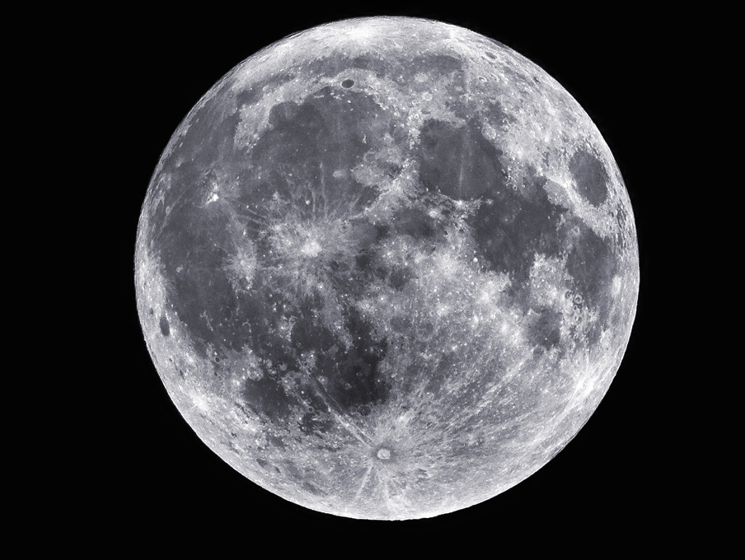
The Moon
NASA/Sean Smith

Slide 5
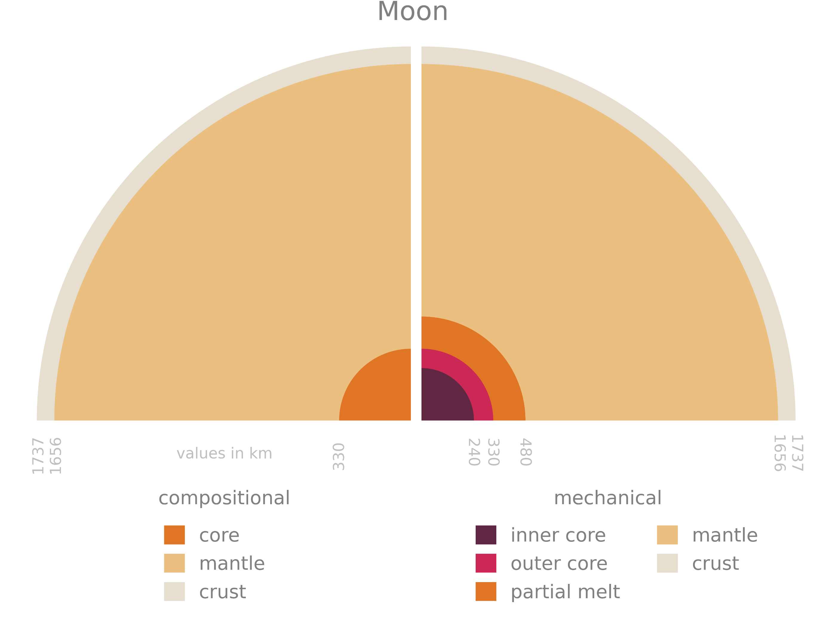
Interior

Slide 6
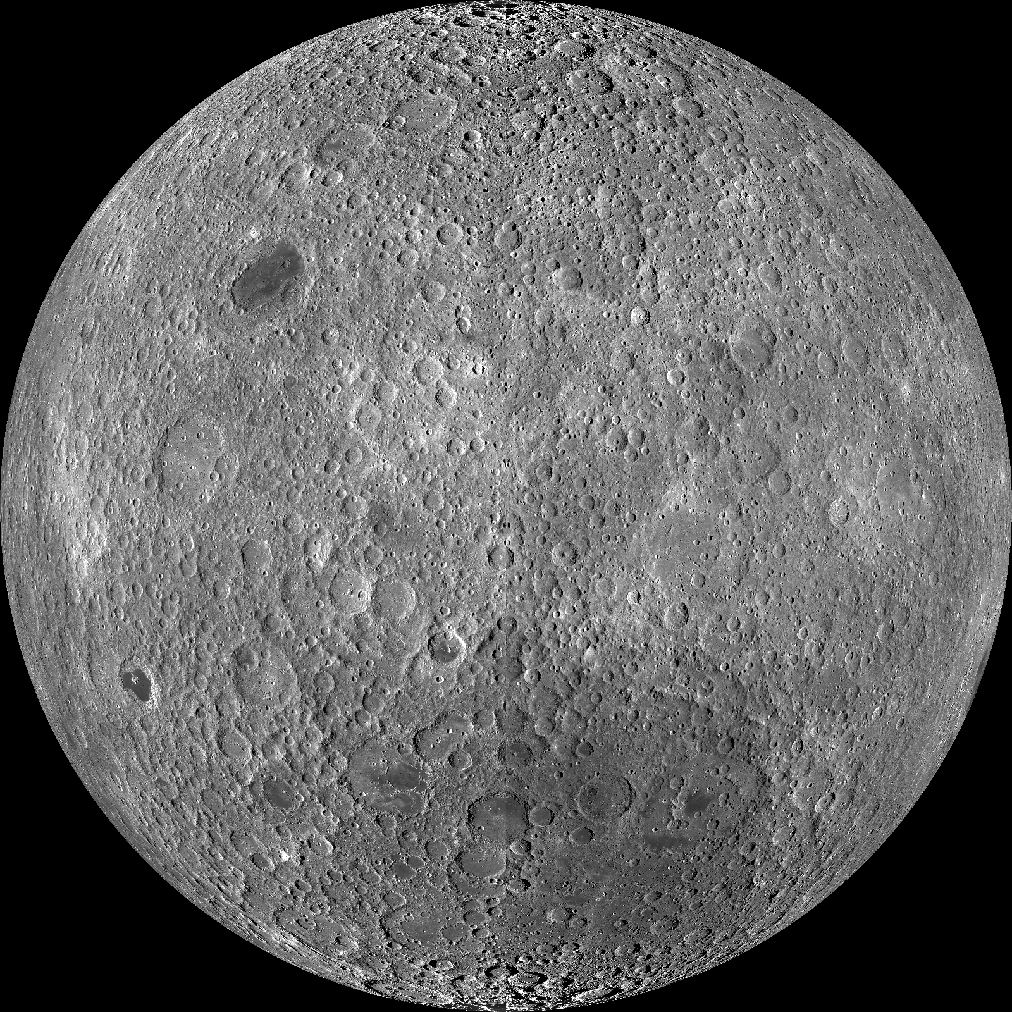
Lunar Surface
NASA/Goddard/Arizona State University
Notes:
Mare – Latin for Seas
Craters dominate
Mare are from lava flows
Covered in a layer of regolith (soil)
Image is of the Lunar Farside

Slide 7
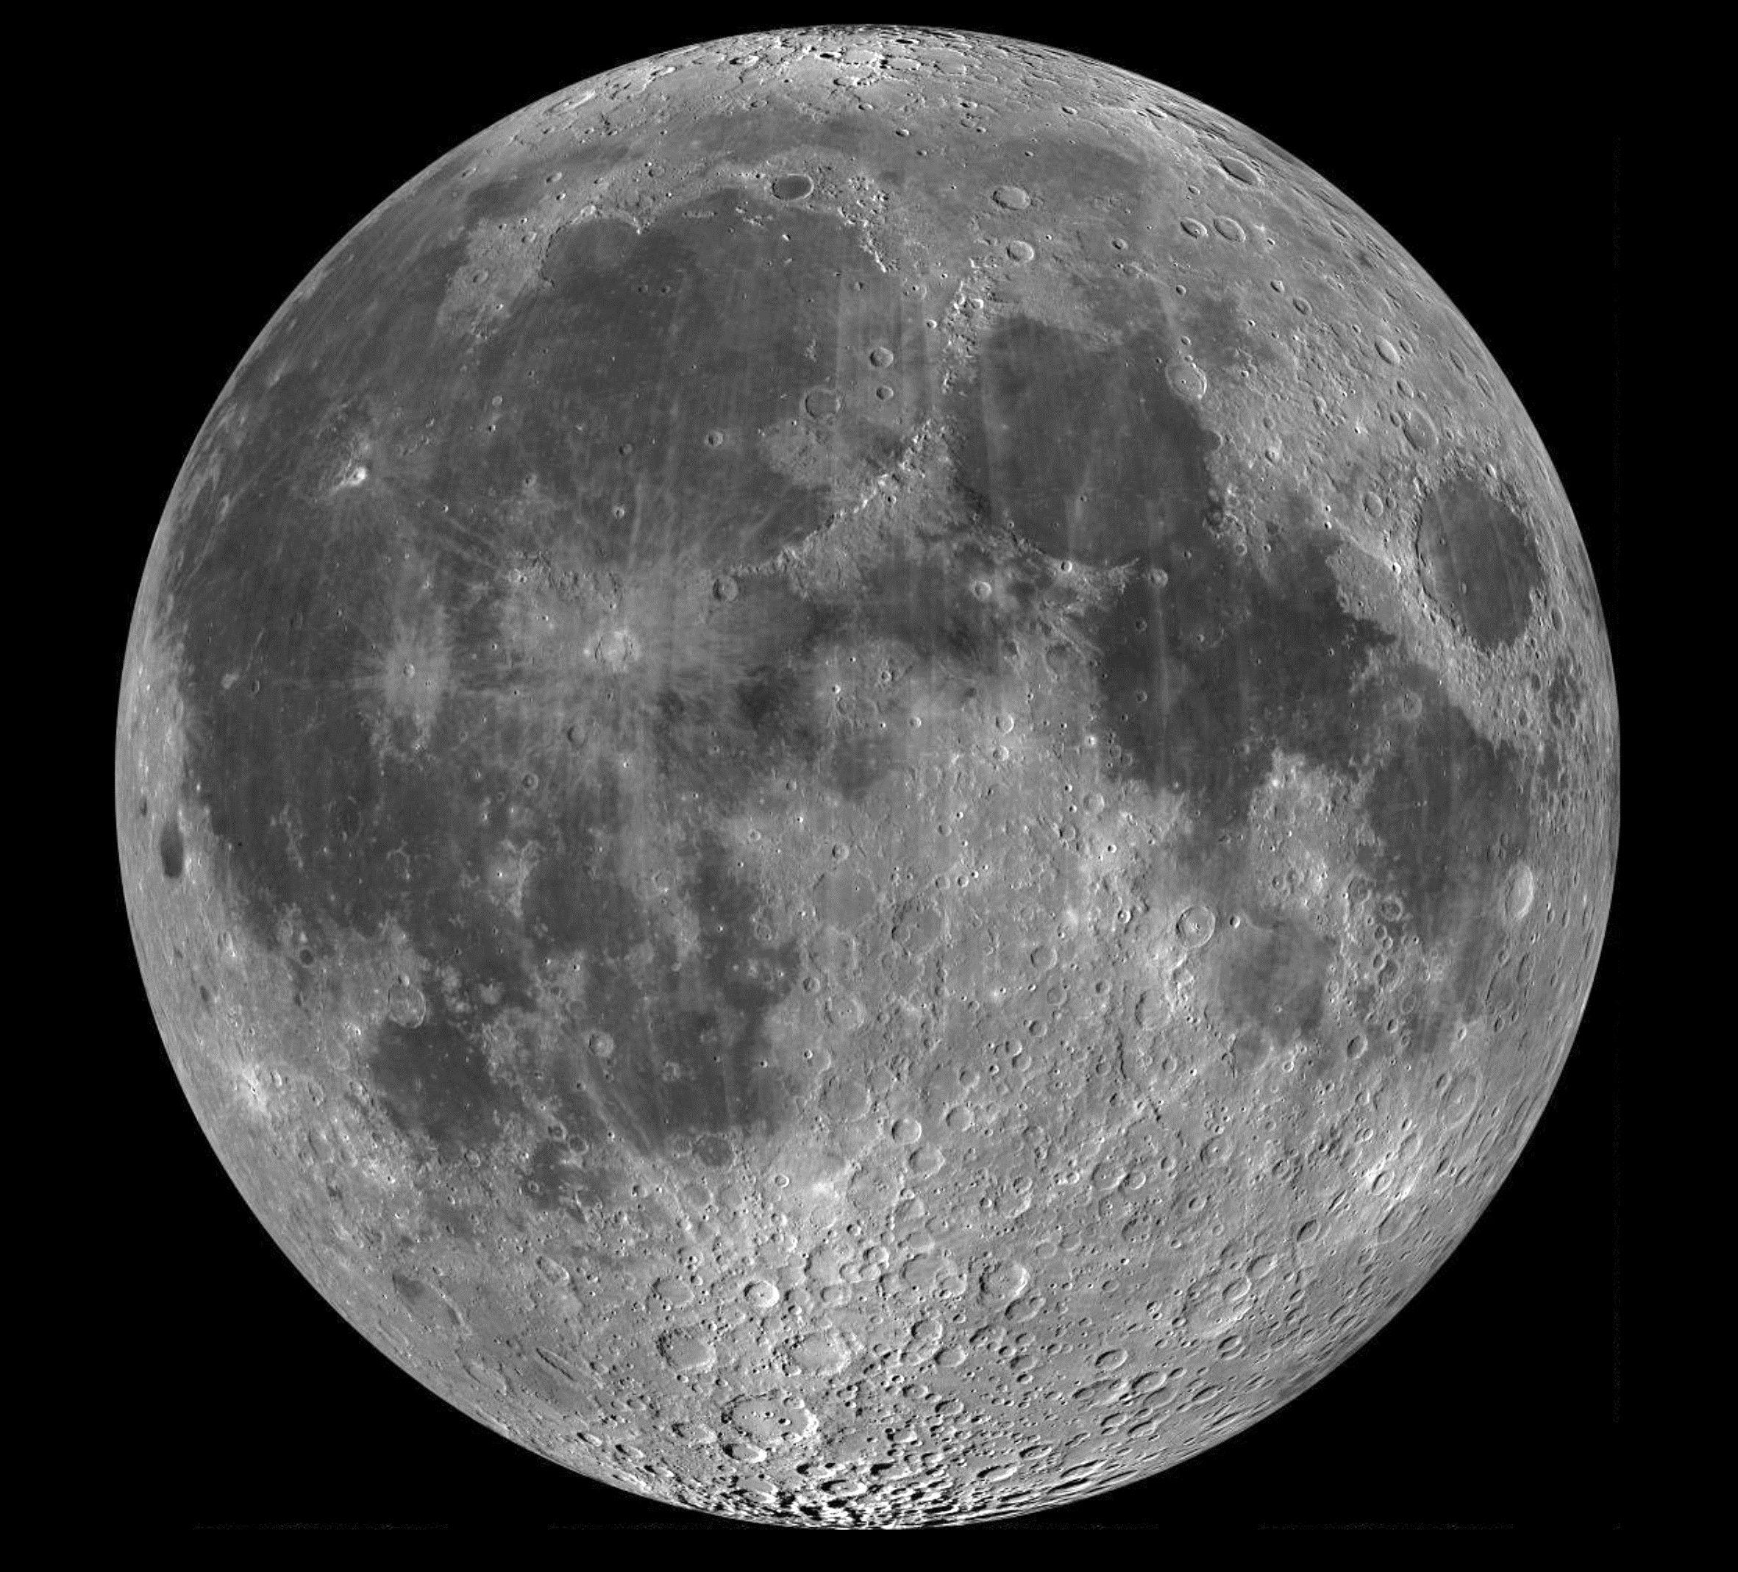
Lunar Surface
NASA/Goddard/Arizona State University
Notes:
Lunar Reconnaissance Orbiter Images nearside then farside
Interactive - http://lroc.sese.asu.edu/posts/298

Slide 8
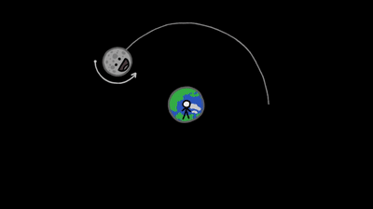
Tidally Locked

Slide 9
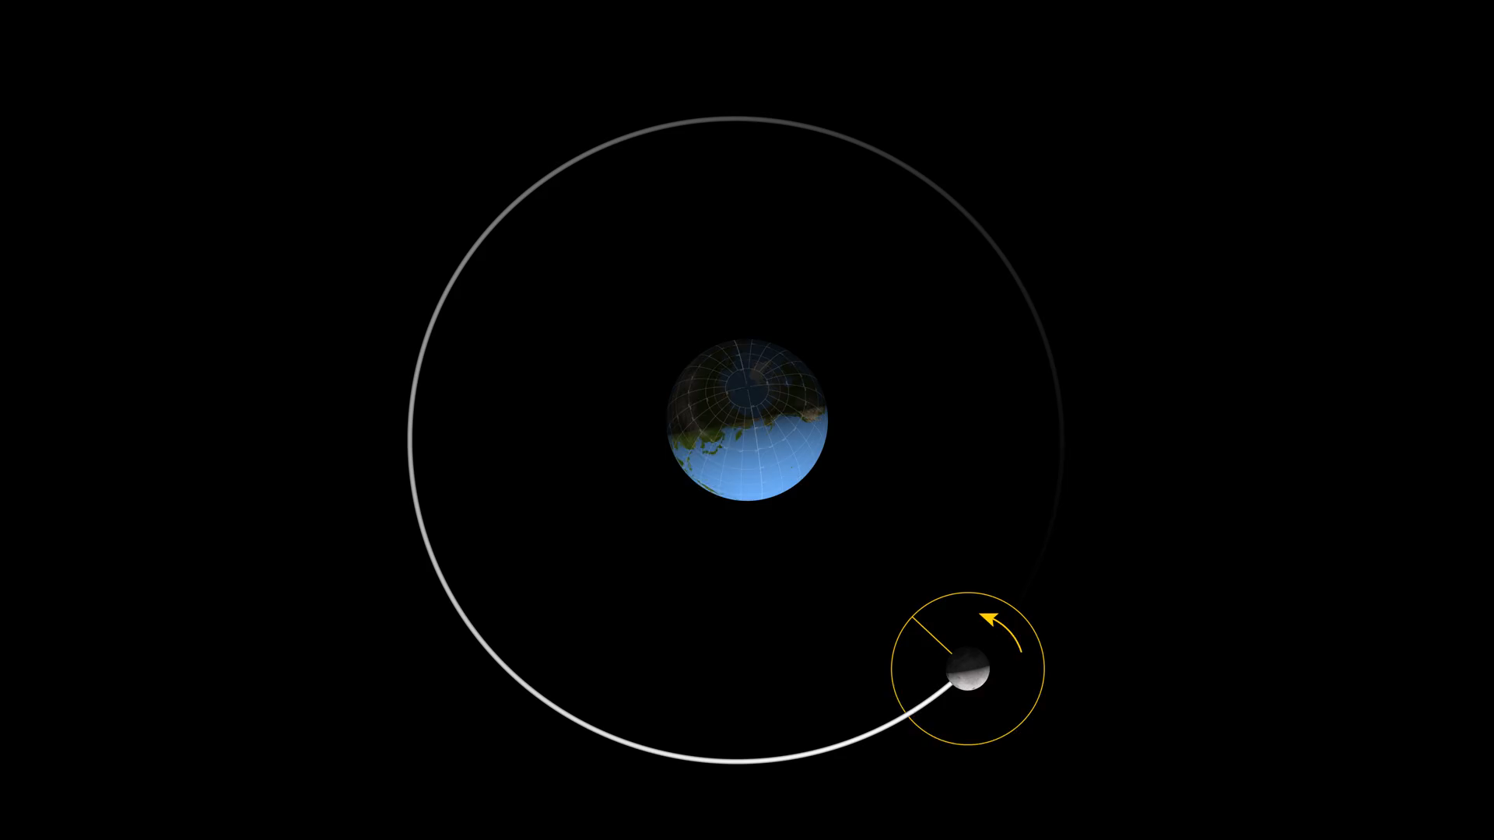
Tidally Locked
Notes:
https://svs.gsfc.nasa.gov/vis/a000000/a004700/a004709/

Slide 10
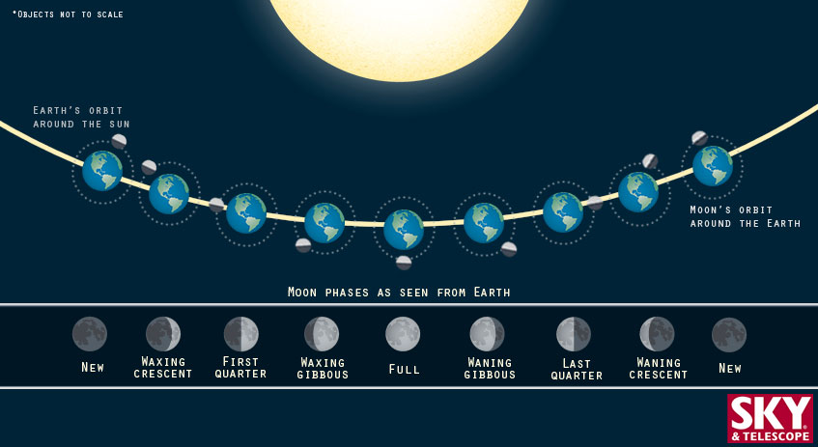
Phases of the Moon
S&T: Ana Aceves

Slide 11
The Earth, Moon, and Sun system
Up next:

